Slide 1
Module 11: IPS Technologies
Networking Security v1.0
(NETSEC)
Notes:
Networking Security (NETSEC) Module 11: IPS Technologies

Slide 2
Module Objectives
Module Title: IPS Technologies
Module Objective: Explain how network-based Intrusion Prevention Systems are used to help secure a network.
Topic Title | Topic Objective
IDS and IPS Characteristics | Explain the functions and operations of IDS and IPS systems.
IPS Implementations | Explain how network-based IPS are implemented.
IPS on Cisco ISRs | Describe the IPS technologies that are available on Cisco ISR routers.
Cisco Switched Port Analyzer | Configure Cisco SPAN.
Notes:
2
11 – IPS Technologies
11.0.2 – What will I learn to do in this module?

Slide 3
11.1 IDS and IPS Characteristics
Notes:
11: IPS Technologies 11.1: IDS and IPS Characteristics

Slide 4
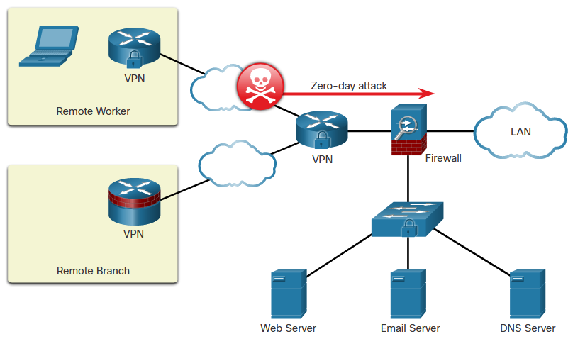
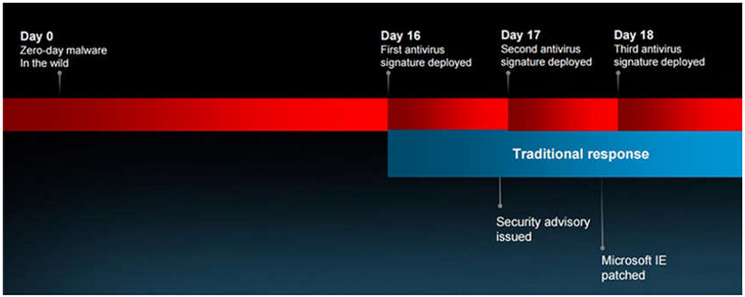
IDS and IPS Characteristics
Zero-Day Attacks
A zero-day attack is a cyberattack that tries to exploit software vulnerabilities that are unknown or undisclosed by the software vendor. The term zero-day describes the moment when a previously unknown threat is identified.
Microsoft Internet Explore Zero-Day Vulnerability
Notes:
11: IPS Technologies 11.1: IDS and IPS Characteristics 11.1.1: Zero-Day Attacks

Slide 5
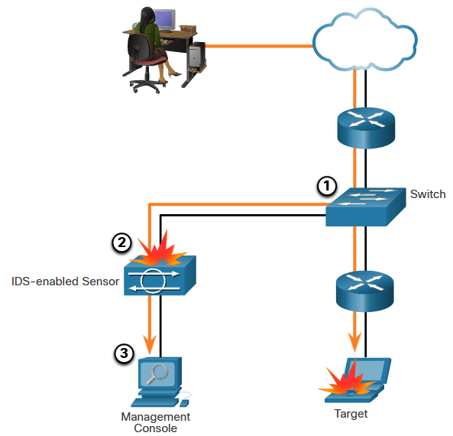
IDS and IPS Characteristics
Monitor for Attacks
Intrusion Detection Systems (IDS) were implemented to passively monitor the traffic on a network. The figure shows that an IDS-enabled device copies the traffic stream and analyzes the copied traffic rather than the actual forwarded packets. A better solution is to use a device that can immediately detect and stop an attack. An Intrusion Prevention System (IPS) performs this function.
Notes:
11: IPS Technologies 11.1: IDS and IPS Characteristics 11.1.2: Monitor for Attacks

Slide 6
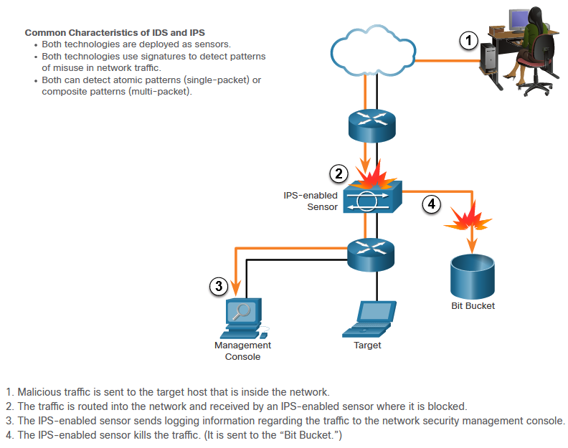
IDS and IPS Characteristics
Intrusion Prevention and Detection Devices
Notes:
11: IPS Technologies 11.1: IDS and IPS Characteristics 11.1.3: Intrusion Prevention and Detection Devices

Slide 7
IDS and IPS Characteristics
Advantages and Disadvantages of IDS and IPS
Solution | Advantages | Disadvantages
IDS | No Impact on network (latency, jitter) No Network impact if there is a sensor failure No network impact if there is sensor overload | Response action cannot stop trigger packets Correct tuning required for response actions More vulnerable to network security evasion techniques
IPS | Stops trigger packets Can use stream normalization techniques | Sensor issues might affect network traffic Sensor overloading impacts the network Some impact on network (latency, jitter)
Notes:
11: IPS Technologies 11.1: IDS and IPS Characteristics 11.1.4: Advantages and Disadvantages of IDS and IPS
11.1.5: Interactive Activity – Compare IDS and IPS Characteristics

Slide 8
11.2 IPS Implementations
Notes:
11: IPS Technologies 11.2: IPS Implementations

Slide 9
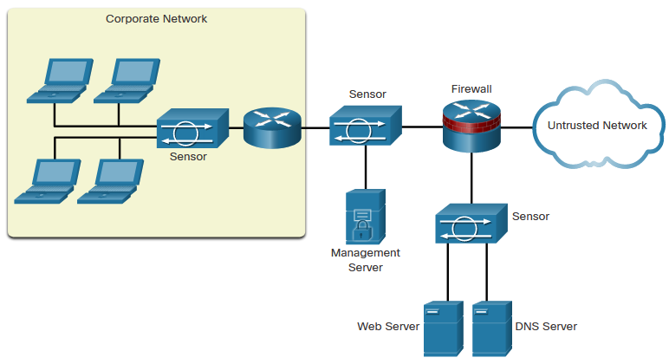
IPS Implementations
Types of IPS
There are two primary kinds of IPS available: host-based IPS (HIPS) and network-based IPS.
HIPS can be thought of as a combination of antivirus software, antimalware software, and a firewall. An example of a HIPS is Windows Defender. It provides a range of protection measures for Windows hosts.
A network-based IPS can be implemented using a dedicated or non-dedicated IPS device such as a router. Network-based IPS implementations are a critical component of intrusion prevention. Host-based IDS/IPS solutions must be integrated with a network-based IPS implementation to ensure a robust security architecture.
Sample IPS Sensor Deployment
Notes:
11: IPS Technologies 11.2: IPS Implementations 11.2.1: Types of IPS

Slide 10
IPS Implementations
Network-Based IPS
Network-based IPS Sensors can be implemented in several ways:
On a Cisco Firepower appliance
On an ASA firewall device
On an ISR router
As an NGIPSv for VMware
The hardware of all network-based sensors includes three components:
NIC - The network-based IPS must be able to connect to any network, such as Ethernet, Fast Ethernet, and Gigabit Ethernet.
Processor - Intrusion prevention requires CPU power to perform intrusion detection analysis and pattern matching.
Memory - Intrusion detection analysis is memory-intensive. Memory directly affects the ability of a network-based IPS to efficiently and accurately detect an attack.
Notes:
11: IPS Technologies 11.2: IPS Implementations 11.2.2: Network-Based IPS

Slide 11

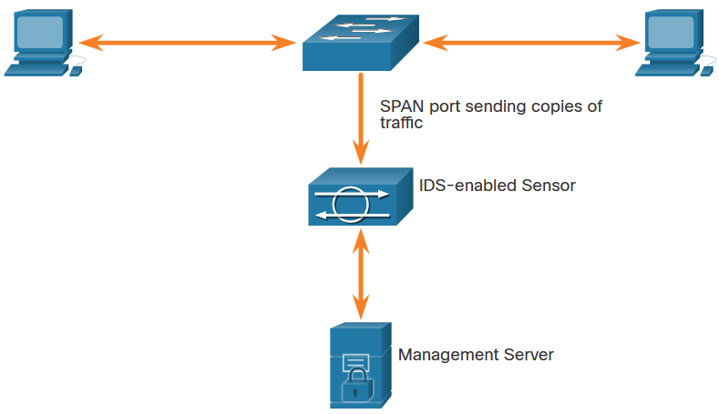
IPS Implementations
Modes of Deployment
Inline Mode
IDS and IPS sensors can operate in inline mode (also known as inline interface pair mode) or promiscuous mode (also known as passive mode).
Promiscuous
Mode
Notes:
11: IPS Technologies 11.2: IPS Implementations 11.2.3: Modes of Deployment
11.2.4: Check Your Understanding – Compare IDS and IPS Deployment

Slide 12
11.3 IPS on Cisco ISRs
Notes:
11: IPS Technologies 11.3: IPS on Cisco ISRs

Slide 13
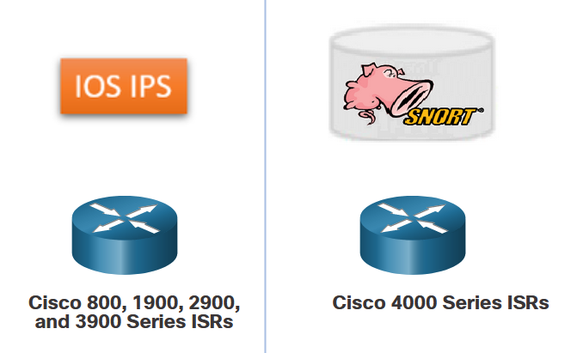
IPS on Cisco ISRs
IPS Components
The IPS detection and enforcement engine that can be implemented depends on the router platform:
Cisco IOS Intrusion Prevention System (IPS)
Cisco Snort IPS
An IPS sensor has two components:
IPS detection and enforcement engine - To validate traffic, the detection engine compares incoming traffic with known attack signatures that are included in the IPS attack signature package.
IPS attack signatures package - This is a list of known attack signatures that are contained in one file. The signature pack is updated frequently as new attacks are discovered. Network traffic is analyzed for matches to these signatures.
Notes:
11: IPS Technologies 11.3: IPS on Cisco ISRs 11.3.1: IPS Components

Slide 14
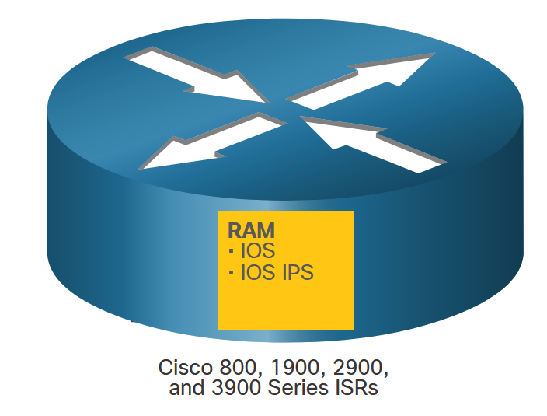
IPS on Cisco ISRs
Cisco IOS IPS
The network administrator could configure the Cisco IOS IPS to choose the appropriate response to various threats. For example, when packets in a session matched a signature, Cisco IOS IPS could be configured to respond as follows:
Send an alarm to a syslog server or a centralized management interface.
Drop the packet.
Reset the connection.
Deny traffic from the source IP address of the threat for a specified amount of time.
Deny traffic on the connection for which the signature was seen for a specified amount of time.
Notes:
11: IPS Technologies 11.3: IPS on Cisco ISRs 11.3.2: Cisco IOS IPS

Slide 15
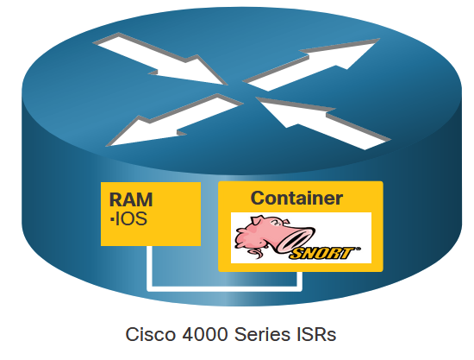
IPS on Cisco ISRs
Snort IPS
Many of the devices that supported Cisco IOS IPS are no longer available, or no longer supported. The newer Cisco 4000 Series Integrated Services Routers (ISR) provide IPS services using the Snort IPS feature. Snort is an open source network IPS that performs real-time traffic analysis and generates alerts when threats are detected on IP networks. It can also perform protocol analysis, content searching or matching, and detect a variety of attacks and probes, such as buffer overflows, stealth port scans, etc.
The Snort engine runs in a virtual service container on Cisco 4000 Series ISRs. A virtual service container is a virtual machine that runs on the ISR router operating system. Service containers are applications that can be hosted directly on Cisco IOS XE routing platforms. The Snort container is distributed as an Open Virtualization Appliance (OVA) file that is installed on the router.
Notes:
11: IPS Technologies 11.3: IPS on Cisco ISRs 11.3.3: Snort IPS

Slide 16
IPS on Cisco ISRs
Snort Operation
Snort IPS signatures are delivered automatically to the ISR by Cisco Talos. Snort can customize rule sets and provide centralized deployment and management capabilities for 4000 Series ISRs.
Snort can be enabled in IDS mode or IPS mode:
IDS mode - Snort inspects the traffic and reports alerts but does not take any action to prevent attacks.
IPS mode - In addition to intrusion detection, actions are taken to prevent attacks.
In the network intrusion detection and prevention mode, Snort performs the following actions:
Monitors network traffic and analyzes against a defined rule set.
Performs attack classification.
Invokes actions against matched rules.
Notes:
11: IPS Technologies 11.3: IPS on Cisco ISRs 11.3.4: Snort Operation

Slide 17
IPS on Cisco ISRs
Snort Features
The table lists the features and benefits of Snort IPS.
Feature | Benefit
Signature-based intrusion detection system (IDS) and intrusion prevention system (IPS) | Snort open-source IPS, capable of performing real-time traffic analysis and packet logging on IP networks, runs on the 4000 Series ISR service container without the need to deploy an additional device at the branch.
Snort rule set updates | Snort rule set updates for 4000 Series ISRs are generated by Cisco Talos, a group of leading-edge network security experts who work around the clock to proactively discover, assess, and respond to the latest trends in hacking activities, intrusion attempts, malware, and vulnerabilities.
Snort rule set pull | The router will be able to download rule sets directly from cisco.com or snort.org to a local server, using one-time commands or periodic automated updates.
Snort rule set push | A centralized management tool can push the rule sets based on preconfigured policy, instead of the router directly downloading on its own.
Signature allowed listing | Allowed listing allows the disabling of certain signatures from the rule set. Disabled signatures can be reenabled at any time.
Notes:
11: IPS Technologies 11.3: IPS on Cisco ISRs 11.3.5: Snort Features

Slide 18
IPS on Cisco ISRs
Snort System Requirements
A security K9 license (SEC) is required to activate Snort IPS functionality. Customers also need to purchase a yearly subscription for the signature package distributed on cisco.com. To keep current with the latest threat protection, Snort rule sets are term-based subscriptions, available for one or three years.
There are two types of term-based subscriptions:
Community Rule Set - Offers limited coverage against threats, focusing on reactive response to security threats versus proactive research work. There is 30-day delayed access to updated signatures in the Community Rule Set, and this subscription does not entitle the customer to Cisco support.
Subscriber Rule Set - Offers the best protection against threats. It includes coverage in advance of exploits by using the research work of the Cisco Talos security experts. The Subscriber Rule Set also provides the fastest access to updated signatures in response to a security incident or the proactive discovery of a new threat. This subscription is fully supported by Cisco.
Notes:
11: IPS Technologies 11.3: IPS on Cisco ISRs 11.3.6: Snort System Requirements
11.3.7: Check Your Understanding – IPS on Cisco ISRs

Slide 19
11.4 Cisco Switched Port Analyzer
Notes:
11: IPS Technologies 11.4: Cisco Switched Port Analyzer

Slide 20
Cisco Switched Port Analyzer
Network Monitoring Methods
The day-to-day operation of a network consists of common patterns of traffic flow, bandwidth usage, and resource access. Together, these patterns identify normal network behavior. Security analysts must be intimately familiar with normal network behavior because abnormal network behavior typically indicates a problem.
To determine normal network behavior, network monitoring must be implemented using IDS, packet analyzers, SNMP, NetFlow, and other tools. Some of these tools require captured network data. There are two common methods used to capture traffic and send it to network monitoring devices:
Network taps, sometimes known as test access points (TAPs)
Traffic mirroring using Switch Port Analyzer (SPAN) or other port mirroring approaches.
Notes:
11: IPS Technologies 11.4: Cisco Switched Port Analyzer 11.4.1: Network Monitoring Methods

Slide 21
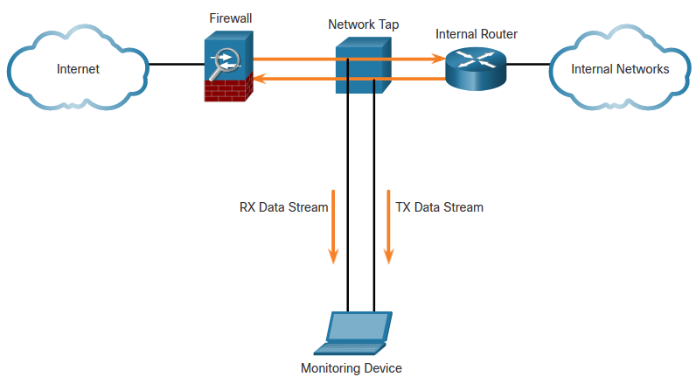
Cisco Switched Port Analyzer
Network Taps
A network tap is typically a passive splitting device implemented inline between a device of interest and the network. A tap forwards all traffic, including physical layer errors, to an analysis device while also allowing the traffic to reach its intended destination. Taps are also typically fail-safe, which means if a tap fails or loses power, traffic between the firewall and internal router is not affected.
Notes:
11: IPS Technologies 11.4: Cisco Switched Port Analyzer 11.4.2: Network Taps

Slide 22
Cisco Switched Port Analyzer
Traffic Mirroring and SPAN
Because capturing data for network monitoring requires all traffic to be captured, special techniques must be employed to bypass the network segmentation imposed by network switches. Port mirroring is one of these techniques. Port mirroring enables the switch to copy frames that are received on one or more ports to a Switch Port Analyzer (SPAN) port that is connected to an analysis device.
The table identifies and describes terms used by the SPAN feature.
SPAN Term | Description
Ingress traffic | Traffic that enters the switch.
Egress traffic | Traffic that leaves the switch.
Source (SPAN) port | Source ports are monitored as traffic entering them is replicated (mirrored) to the destination ports.
Destination (SPAN) port | A port that mirrors source ports. Destination SPAN ports often connect to analysis devices such as a packet analyzer or an IDS.
Notes:
11: IPS Technologies 11.4: Cisco Switched Port Analyzer 11.4.3: Traffic Mirroring and SPAN

Slide 23
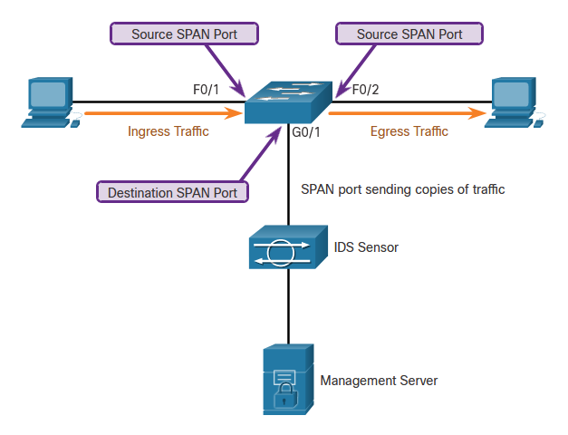
Cisco Switched Port Analyzer
Traffic Mirroring and SPAN (Cont.)
The figure shows a switch that interconnects two hosts and mirrors traffic to an intrusion detection device (IDS) and network management server.
Notes:
11: IPS Technologies 11.4: Cisco Switched Port Analyzer 11.4.3: Traffic Mirroring and SPAN(Cont.)

Slide 24
Cisco Switched Port Analyzer
Configure Cisco SPAN
The SPAN feature on Cisco switches sends a copy of each frame entering the source port out the destination port and toward the packet analyzer or IDS. A session number is used to identify a SPAN session. The figure shows the monitor session command, used to associate a source port and a destination port with a SPAN session. A VLAN can be specified instead of a physical port.
Notes:
11: IPS Technologies 11.4: Cisco Switched Port Analyzer 11.4.4: Configure Cisco SPAN using Intrusion Detection
11.4.5: Syntax Checker – Configure and Verify SPAN

Slide 25
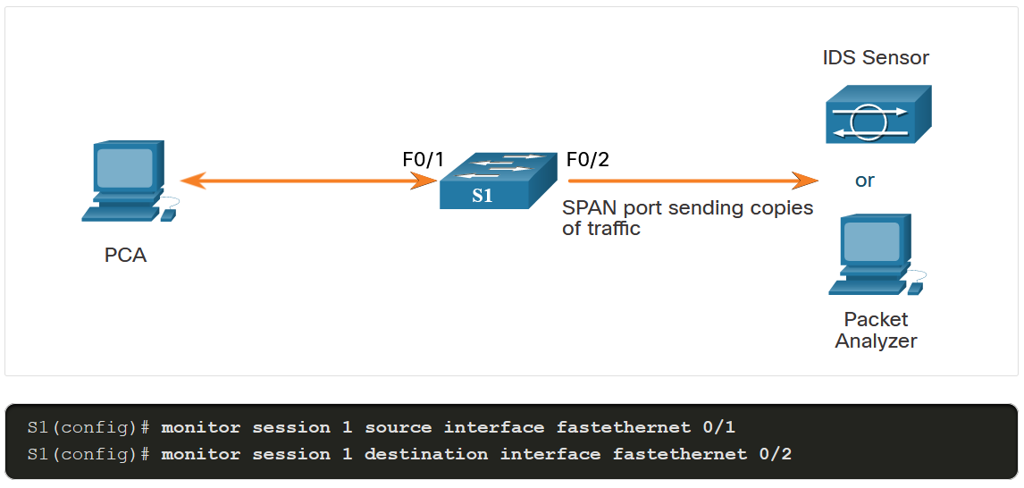
Cisco Switched Port Analyzer
Configure Cisco SPAN (cont.)
In this example, PCA is connected to F0/1 and an IDS is connected to F0/2. The objective is to capture all the traffic that is sent or received by PCA on port F0/1 and send a copy of those frames to the IDS (or a packet analyzer) on port F0/2. The SPAN session on the switch will copy all the traffic that it sends and receives on source port F0/1 to the destination port F0/2.
For more ports:
monitor session 1 source interface fa0/1 - 10 monitor session 1 destination interface gi0/0
Notes:
11: IPS Technologies 11.4: Cisco Switched Port Analyzer 11.4.4: Configure Cisco SPAN using Intrusion Detection
11.4.5: Syntax Checker – Configure and Verify SPAN

Slide 26
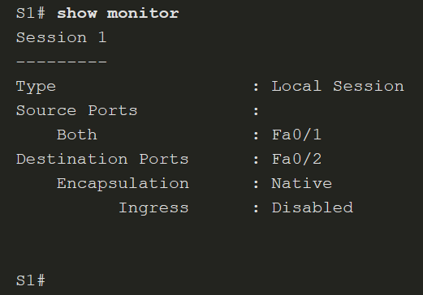
Cisco Switched Port Analyzer
Configure Cisco SPAN (cont.)
The show monitor command is used to verify the SPAN session.
Notes:
11: IPS Technologies 11.4: Cisco Switched Port Analyzer 11.4.4: Configure Cisco SPAN using Intrusion Detection
11.4.5: Syntax Checker – Configure and Verify SPAN

Slide 27
Module 12: IPS Operation and Implementation
Networking Security v1.0
(NETSEC)
Notes:
Networking Security (NETSEC) Module 12: IPS Operation and Implementation

Slide 28
Module Objectives
Module Title: IPS Operation and Implementation
Module Objective: Explain how signatures are used to detect malicious network traffic.
Topic Title | Topic Objective
IPS Signatures | Describe IPS signatures.
Cisco Snort IPS | Explain how the Cisco Snort IPS provides network security services.
Configure Snort IPS | Explain how to configure Snort IPS on a Cisco ISR G2.
Notes:
28
12 – IPS Operation and Implementation
12.0.2 – What will I learn in this module?

Slide 29
12.1 IPS Signatures
Notes:
12: IPS Operation and Implementation 12.1: IPS Signatures

Slide 30
IPS Signatures
IPS Signature Attributes
The network must be able to identify incoming malicious traffic in order to stop it. Fortunately, malicious traffic displays distinct characteristics or “signatures”. Signatures uniquely identify specific viruses, worms, protocol anomalies, and malicious traffic.
PS sensors must be tuned to look for matching signatures or abnormal traffic patterns. As sensors scan network packets, they use signatures to detect known attacks and respond with predefined actions. An IDS or IPS sensor examines the data flow using many different signatures.
Signatures have three distinctive attributes:
Type - Atomic or Composite
Trigger - Also called the alarm
Action - What the IPS will do
Notes:
12: IPS Operation and Implementation 12.1: IPS Signatures 12.1.1: IPS Signature Attributes

Slide 31
IPS Signatures
Types of Signatures
Some threats can be identified in one packet while other threats may require many packets and their state information (i.e., IP addresses, port numbers, and more) to identify a threat.
There are two types of signatures:
Atomic Signature - This is the simplest type of signature because a single packet, activity, or event identifies an attack. The IPS does not need to maintain state information and traffic analysis can usually be performed very quickly and efficiently.
Composite Signature - Also called a stateful signature because the IPS requires several pieces of data to match an attack signature. The IPS must also maintain state information which is referred to as the event horizon. The length of an event horizon varies from one signature to the next.
The heart of any IPS signature is the signature alarm, which is often referred to as the signature trigger.
Notes:
12: IPS Operation and Implementation 12.1: IPS Signatures 12.1.2: Types of Signatures

Slide 32
IPS Signatures
IPS Signature (Triggers) Alarms
Every IPS incorporates signatures that use one or more of these basic triggering mechanisms to trigger signature actions. There are four general IPS signature trigger categories as listed in the table.
Detection Type | Advantages
Pattern-Based Detection | Also known as signature-based detection. Simplest triggering mechanism as it searches for a specific and pre-defined atomic or composite pattern. A IPS sensor compares the network traffic to a database of known attacks, and triggers an alarm or prevents communication if a match is found.
Anomaly-Based Detection | Also known as profile-based detection. Involves first defining a profile of what is considered normal network or host activity. This normal profile is usually defined by monitoring traffic and establishing a baseline. Once defined, any activity beyond a specified threshold in the normal profile will generate a signature trigger and action.
Policy-Based Detection | Also known as behavior-based detection. Although similar to pattern-based detection, an administrator manually defines behaviors that are suspicious based on historical analysis. The use of behaviors enables a single signature to cover an entire class of activities without having to specify each individual situation.
Honey Pot-Based Detection | Honey pot-based detection uses a server as a decoy server to attract attacks. The purpose of a decoy server is to lure attacks away from production devices. Allows administrators time to analyze incoming attacks and malicious traffic patterns to tune their sensor signatures.
Notes:
12: IPS Operation and Implementation 12.1: IPS Signatures 12.1.3: IPS Signature Alarms

Slide 33
IPS Signatures
IPS Signature Actions
Alert Category | Specific Action | Description
Generate an alert | Produce alert | The IPS sends events as alerts.
Generate an alert | Produce verbose alert | The IPS sends a detailed event alert.
Log the activity | Log attacker packets | Logs packets from the attacker IP address and sends an alert.
Log the activity | Log pair packets | Logs packets from the victim and attacker IP addresses and sends an alert.
Log the activity | Log victim packets | Logs packets from the victim IP address and sends an alert.
Deny the activity | Deny attacker inline | Terminates the current packet and future packets from this attacker address for a specified period of time.
Deny the activity | Deny connection inline | Logs packets from the victim IP address and sends an alert.
Deny the activity | Deny packet inline | Terminates the current packet and future packets from this attacker address for a specified period of time.
Notes:
12: IPS Operation and Implementation 12.1: IPS Signatures 12.1.4: IPS Signature Actions

Slide 34
IPS Signatures
IPS Signature Actions (Cont.)
Alert Category | Specific Action | Description
Reset the TCP connection | Reset TCP connection | Sends TCP resets to hijack and terminate the TCP flow.
Block future activity | Request block connection | Sends a request to a blocking device to block this connection.
Block future activity | Request block host | Sends a request to a blocking device to block this attacker host.
Block future activity | Request SNMP trap | Sends a request to the notification application component of the sensor to perform SNMP notification.

Slide 35
IPS Signatures
Evaluating Alerts
The table summarizes the following four types of alarms.
Alarm Type | Network Activity | IPS Activity | Outcome
True positive | Attack traffic | Alarm generated | Ideal setting
True negative | Normal user traffic | No alarm generated | Ideal setting
False positive | Normal user traffic | Alarm generated | Tune alarm
False negative | Attack traffic | No alarm generated | Tune alarm
Notes:
12: IPS Operation and Implementation 12.1: IPS Signatures 12.1.5: Evaluating Alerts

Slide 36
IPS Signatures
Evaluating Alerts (Cont.)
Alerts can be classified as follows:
True positive - (Desirable) This is used when the IPS generates an alarm because it detected know attack traffic. The alert has been verified to be an actual security incident and also indicates that the IPS rule worked correctly.
True negative - (Desirable) This is used when normal network traffic does not generate an alarm. No alerts are issued because the traffic that is passing through the system is clear of threats.
False positive - (Undesirable) This is used when an IPS generates an alarm after processing normal user traffic that should not have triggered an alarm. The IPS must be tuned to change these alarm types to true negatives. The alert does not indicate an actual security incident. Benign activity that results in a false positive is sometimes referred to as a benign trigger. False positives are costly because they must be investigated.
False negative - (Dangerous) This is used when an IPS fails to generate an alarm and known attacks are not being detected. This means that exploits are not being detected by the security systems that are in place. These incidents could go undetected for a long time, and ongoing data loss and damage could result. The goal is for these alarm types to generate true positive alarms.
Notes:
12: IPS Operation and Implementation 12.1: IPS Signatures 12.1.5: Evaluating Alerts
12.1.6: Check Your Understanding – IPS Signature Actions

Slide 37
12.2 Cisco Snort IPS
Notes:
12: IPS Operation and Implementation 12.2: Cisco Snort IPS

Slide 38
Cisco Snort IPS
Cisco IPS
Organizations now have three options available to provide intrusion prevention services.
Cisco Firepower Next-Generation IPS (NGIPS) - These are dedicated in-line threat prevention appliances that provide industry leading effectiveness against both known and unknown threats.
Cisco Snort IPS - This is an IPS service that can be enabled on a second generation ISR (ISR G2) (i.e., ISR 4000s). Note that Cisco 4000 ISRs no longer support Cisco IOS IPS.
External Snort IPS Server - This is similar to the Cisco Snort IPS solution but requires a promiscuous (i.e., a SPAN switch port) port and an external Snort IDS/IPS.
Notes:
12: IPS Operation and Implementation 12.2: Cisco Snort IPS 12.2.1: Cisco IPS

Slide 39
Cisco Snort IPS
NGIPS
NGIPS are dedicated IPS appliances. They are built on the core open technology of Snort and use vulnerability-focused IPS rules and embedded IP-, URL-, and DNS-based security intelligence that is provided by Cisco’s Talos Security Intelligence and Research Group.
NGIPS features include:
IPS rules that identify and block attack traffic that target network vulnerabilities
Tightly integrated defense against advanced malware incorporating advanced analysis of network and endpoint activity
Sandboxing technology that uses hundreds of behavioral indicators to identify zero-day and evasive attacks
Also includes Application Visibility and Control (AVC), Cisco Advanced Malware Protection (AMP) for Networks, and URL Filtering
Notes:
12: IPS Operation and Implementation 12.2: Cisco Snort IPS 12.2.2: NGIPS

Slide 40
Cisco Snort IPS
Snort IPS
Snort is an open source network IPS that performs real-time traffic analysis and generates alerts when threats are detected on IP networks. It can also perform protocol analysis, content searching or matching, and detect a variety of attacks and probes, such as buffer overflows, stealth port scans, and so on.
Snort IPS on the 4000 Series ISR provides the following functionalities:
Intrusion detection system (IDS) and IPS mode
Three signature levels
An allowed list
Snort health monitoring
Fail open and close
Signature update
Event logging
Notes:
12: IPS Operation and Implementation 12.2: Cisco Snort IPS 12.2.3: Snort IPS

Slide 41
Cisco Snort IPS
Snort Components and Rules
Snort IPS for 4000 Series ISRs consists of two components:
Snort engine - This is the IPS detection and enforcement engine that is included in the SEC license for 4000 Series ISRs.
Snort rule software subscriptions for signature updates - Snort rule sets to keep current with the latest threat protection are term-based subscriptions, available for one or three years.
To address the rapidly evolving threat landscape, it is important to ensure that signatures are as up-to-date as possible.
There are two types of term-based subscriptions:
Community Rule Set - Available for free, the rules that are provided offer limited coverage against threats. The community rule set focuses on reactive response to security threats versus proactive research work. There is also a 30-day delayed access to updated signatures meaning that newest rule will be a minimum of 30 days old. In addition, there is no Cisco customer support available.
Subscriber Rule Set - Available for a fee, this service provides the best protection against threats. It includes coverage of advance of exploits by using the research work of the Cisco Talos security experts. The Subscriber Rule Set also provides the fastest access to updated signatures in response to a security incident or the proactive discovery of a new threat. This subscription is fully supported by Cisco.
Notes:
12: IPS Operation and Implementation 12.2: Cisco Snort IPS 12.2.4: Snort Components and Rules

Slide 42
Cisco Snort IPS
ISR Container Applications
Routers were initially packet processing devices. Routers have acquired so much processing power that server applications can now be hosted inside the router using service containers.
Service containers are virtual machines that run on the routers. Applications such as Snort IPS can be uploaded and hosted on these routers. Service containers are supported on most IOS XE platforms. IOS XE is based on the Linux architecture and supports virtual machine hosting.
The Snort engine runs as a Linux Service Container application on the ISR 4000. This provides it with dedicated computing resources that run independently of the data plane CPU load. It also makes it easier for the Snort engine to be regularly updated.
Notes:
12: IPS Operation and Implementation 12.2: Cisco Snort IPS 12.2.5: ISR Container Applications

Slide 43
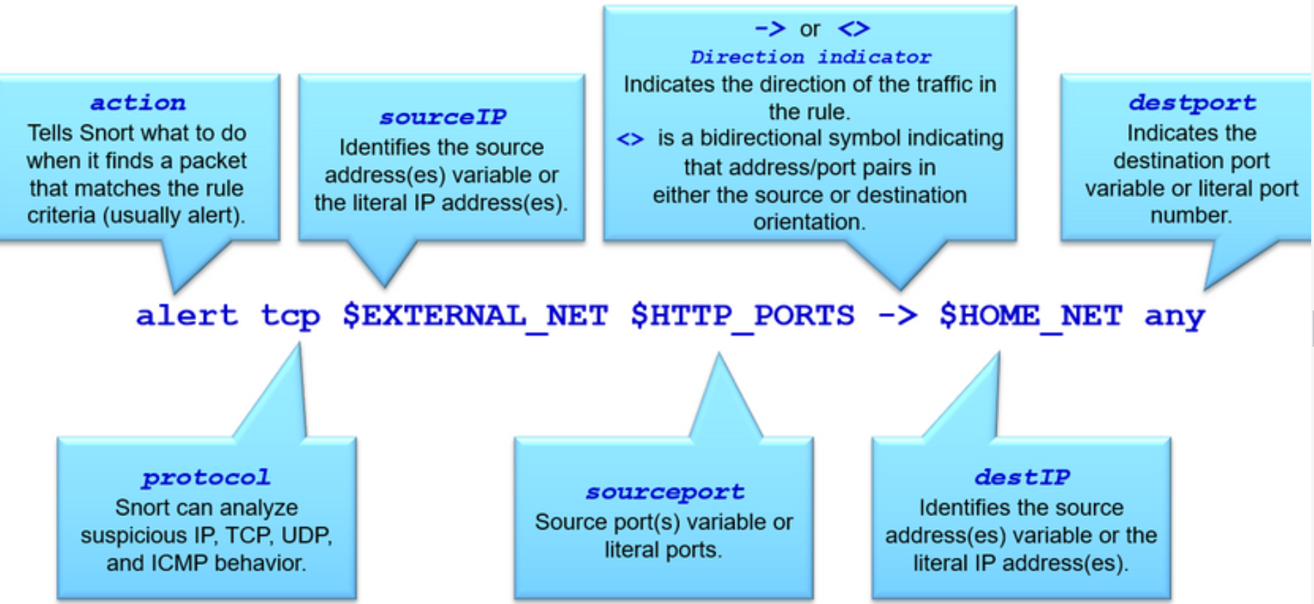
Cisco Snort IPS
Snort IPS Rule Alarms
In Snort IPS, signatures are configured using “rules”. These rules serve as the signature alarms by comparing incoming traffic to the Snort rules. Traffic matching a rule header generates an action. A rule header is conceptually similar to an access control list (ACL) statement (i.e., ACE). It is a one line statement that identifies malicious traffic.
The basic rule header command syntax is:
[action] [protocol] [sourceIP] [sourceport] -> [destIP] [destport] ([Rule options])
Refer to the figure for more information regarding the rule header command syntax.
Notes:
12: IPS Operation and Implementation 12.2: Cisco Snort IPS 12.2.6: Snort IPS Rule Alarms

Slide 44
Snort IPS Rule Alarms
Jednoduché pravidlo ICMP (ping) detekuje ICMP Echo Request (ping) pakety a generuje upozornenie.
alert icmp any any -> any any (msg:"ICMP Echo Request Detected"; sid:1000001; rev:1;)
Pravidlo pre detekciu na prístup na HTTP port (80) v rámci siete 192.168.1.0/24 a generuje upozornenie.
alert tcp any any -> 192.168.1.0/24 80 (msg:"HTTP Access Detected"; sid:1000002; rev:1;)
Pravidlo detekuje všetku TCP komunikáciu z IP adresy 192.168.1.100 a generuje upozornenie
alert tcp 192.168.1.100 any -> any any (msg:"Traffic from Specific IP Detected"; sid:1000003; rev:1;)

Slide 45
Cisco Snort IPS
Snort IPS Rule Actions
Snort can be enabled in IDS mode or in IPS mode.
Snort IDS mode can perform the following three actions:
Alert - Generate an alert using the selected alert method, and then log the packet.
Log - Log the packet.
Pass - Ignore the packet.
Snort IPS mode can perform all of the IDS actions plus the following:
Drop - Block and log the packet.
Reject - Block the packet, log it, and then send a TCP reset if the protocol is TCP or an ICMP port unreachable message if the protocol is UDP.
Sdrop - Block the packet but do not log it.
Notes:
12: IPS Operation and Implementation 12.2: Cisco Snort IPS 12.2.7: Snort IPS Rule Actions

Slide 46
Cisco Snort IPS
Snort IPS Header Rule Options
A Snort rule header also contains rule options (fields) to provide additional information for the rule. Options are separated by semicolons (;) and the rule option keywords are separated from their arguments using colons (:).
The table describes the common general rule and the detection rule options in the sample rule header.
Rule Option | Specific Action
msg: | This is a simple text string that provides a meaningful message to output when the rule matches.
flow: | Specifies the direction of network traffic.
content: | A detection rule option that allows the user to set rules that search for specific content in the packet payload and trigger response based on that data. The option data can contain mixed text and binary data
distance: / offset: | Detection rule keywords that allow the rule writer to specify where to start searching relative to the beginning of the payload or the beginning of a content match.
within: / depth: | Detection rule keywords that allow the rule write to specify how far forward to search relative to the end of a previous content match and, once that content match is found, how far to search for it.
pcre | A detection rule keyword that allows rules to be written using “perl compatible regular expressions” which allows for more complex matches.
Notes:
12: IPS Operation and Implementation 12.2: Cisco Snort IPS 12.2.8: Snort IPS Header Rule Options

Slide 47
Cisco Snort IPS
Snort IPS Header Rule Options (Cont.)
The table describes the common general rule and the detection rule options in the sample rule header.
Rule Option | Specific Action
byte_test | A detection rule keyword that allows a rule to test a number of bytes against a specific value in binary.
metadata: | Allows a rule writer to embed additional information about the rule.
reference: | Allows rules to include references to external sources of information.
classtype: | Identifies the potential effect of what a successful attack would be.
sid / rev | The sid is a unique identifier for each rule making them easy to identify. It should be used with the rev (revision) keyword.
Notes:
12: IPS Operation and Implementation 12.2: Cisco Snort IPS 12.2.8: Snort IPS Header Rule Options

Slide 48
Cisco Snort IPS
Snort IPS Operation
Packets arriving on Snort enabled interfaces are inspected as follows:
Cisco IOS Software forwards the packets to be inspected to the Snort IPS engine using an internal virtual port group (VPG) interface.
Snort IPS inspects the traffic and takes necessary action.
Snort drops the packets associated with bad flows (IPS mode). Good flow packets are returned back to the router for further processing.
Packet exchange between the container applications and the IOS data plane is done using VPG interfaces. These routed interfaces are connected through the router back plane. The corresponding interface on the container side will appear as virtual Ethernet ports.
Notes:
12: IPS Operation and Implementation 12.2: Cisco Snort IPS 12.2.9: Snort IPS Operation

Slide 49
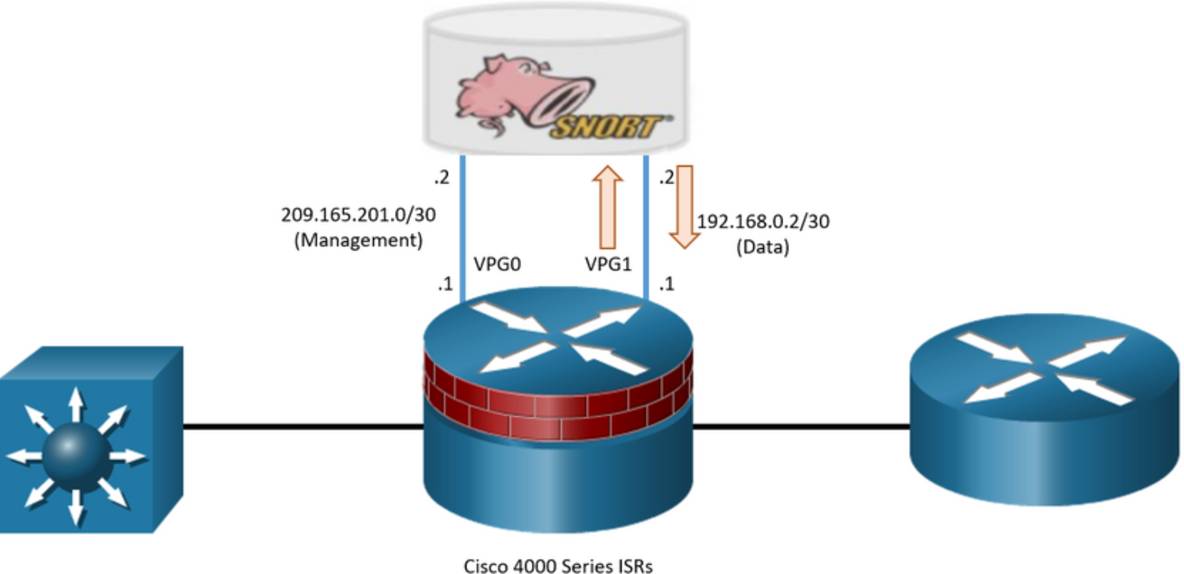
Cisco Snort IPS
Snort IPS Operation
Snort IPS requires two VPG interfaces:
Management interface - This is the interface that is used to source logs to the log collector and for retrieving signature updates from Cisco.com. For this reason, this interface requires a routable IP address.
Data interface - This is the interface that is used to send user traffic between the Snort virtual container service and the router forwarding plane.
In the figure, VPG0 is used for Snort management traffic while VPG1 is used for user traffic to be inspected. User traffic to be inspected is forwarded to the Snort engine using VPG1 as shown. Traffic is then inspected and either rejected (dropped) or forwarded back to the router.
Notes:
12: IPS Operation and Implementation 12.2: Cisco Snort IPS 12.2.9: Snort IPS Operation
12.2.10: Check Your Understanding - Snort IPS

Slide 50
12.3 Configure Snort IPS
Notes:
12: IPS Operation and Implementation 12.3: Configure Snort IPS

Slide 51
Configure Snort IPS
Snort IPS Configuration Steps
To deploy Snort IPS on supported devices, perform the following tasks:
Download the Snort OVA file.
Install the OVA file.
Configure VirtualPortGroup interfaces.
Activate the virtual services.
Configure Snort specifics (e.g., IPS or IDS mode, policy, reporting of events to an external alert/log server or IOS syslog or both, and the Signature update method.
Enable IPS globally or on desired interfaces.
Verify Snort.
Notes:
12: IPS Operation and Implementation 12.3: Configure Snort IPS 12.3.1: Snort IPS Configuration Steps

Slide 52
Configure Snort IPS
Step 1. Download the Snort OVA File
An Open Virtualization Archive (OVA) is a file that contains a compressed, installable version of a virtual machine.
The service OVA file is not bundled with the Cisco IOS XE Release images installed on the router. although the OVA files may be preinstalled in the flash of the router, it is recommended that the latest OVA file be downloaded from Cisco.com.
Notes:
12: IPS Operation and Implementation 12.3: Configure Snort IPS 12.3.2: Download the Snort OVA File

Slide 53
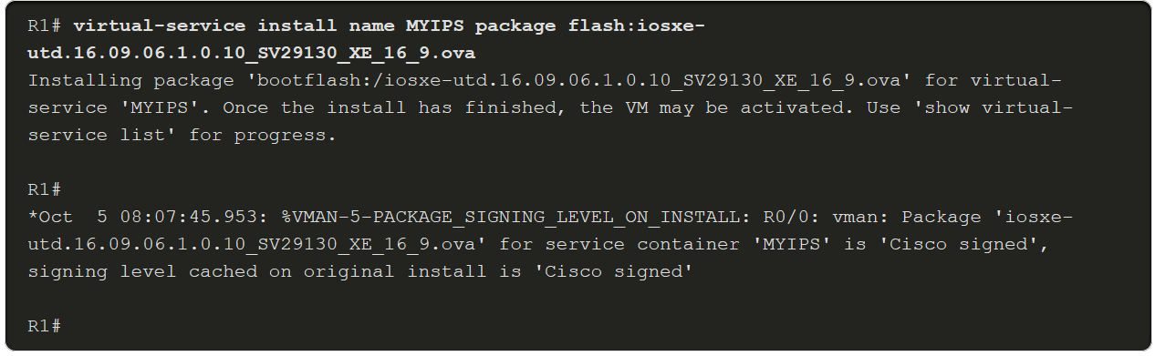
Configure Snort IPS
Step 2. Install the Snort OVA File
The OVA file must be downloaded and saved in a file location available to the ISR router (e.g., Flash).
To install, the OVA file, use the virtual-service install name virtual-service-name package file-url media file-system privilege EXEC command to install the OVA file to the router. The length of the name is 20 characters and the complete path to the OVA file must be specified.
An example configuration is shown below.
Use the show virtual-service list command to display the status of the installation of all applications installed on the virtual service container.
Notes:
12: IPS Operation and Implementation 12.3: Configure Snort IPS 12.3.3: Install the Snort OVA File

Slide 54
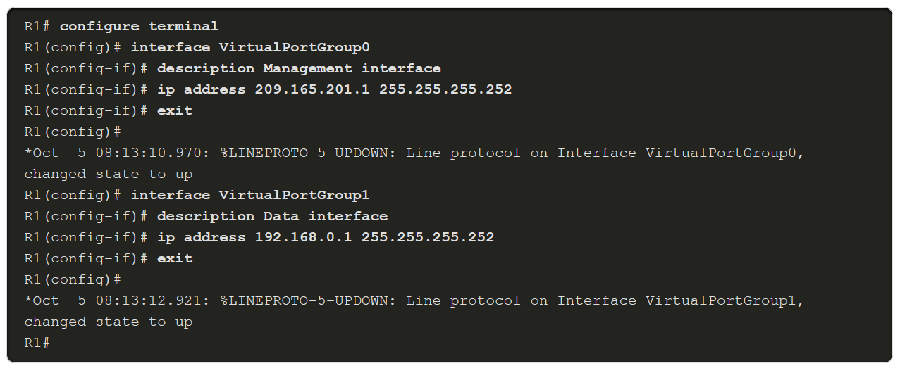
Configure Snort IPS
Step 3. Configure Virtual Port Group Interfaces
Two VirtualPortGroup (VPG) interfaces must then be configured along with their guest IP addresses.
In our example, the VPG interfaces will be configured as follows:
VGP0 - This is for management traffic to exchange information with IPS servers. The guest IP address needs to be routable to connect to the signature update server and external log server. It is also used to log traffic to log collectors.
VPG1 - This is for user traffic marked that should be inspected. This should not be routable and therefore use a non-routable private IP address.
This is a sample configuration of VPG0 and VPG1.
Notes:
12: IPS Operation and Implementation 12.3: Configure Snort IPS 12.3.4: Configure Virtual Port Group Interfaces

Slide 55
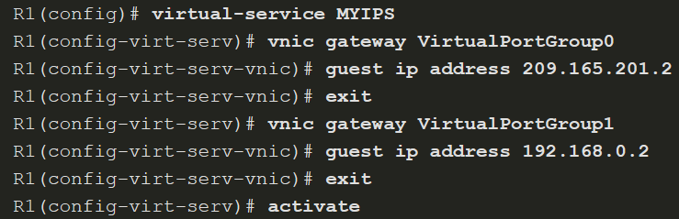
Configure Snort IPS
Step 4. Activate Virtual Services
The next step is to configure guest IPs on the same subnet for the container side and activate the virtual service.
The virtual-service MYIPS command configures the logical name that is used to identify the virtual container service.
The vnic gateway VirtualPortGroup interface-number command creates a virtual network interface card (vNIC) gateway interface for the virtual container service.
The guest ip address command configures a guest vNIC address for the vNIC gateway interface.
Finally, the activate command activates the application installed in a virtual container service.
Notes:
12: IPS Operation and Implementation 12.3: Configure Snort IPS 12.3.5: Activate Virtual Services

Slide 56
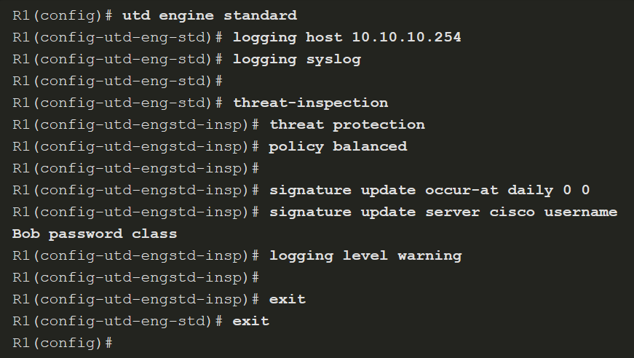
Configure Snort IPS
Step 5. Configure Snort Specifics
The utd engine standard command configures the united threat defense (UTD) standard engine and enters UTD standard engine configuration mode.
The logging host and logging syslog commands enable the logging of emergency messages to a server.
The threat-inspection command configures threat inspection for the Snort engine. From here you can specify which mode Snort will be in:
threat protection - Snort will be in IPS mode.
threat detection - Snort will be in IDS mode.
Notes:
12: IPS Operation and Implementation 12.3: Configure Snort IPS 12.3.6: Configure the Snort Specifics

Slide 57
Configure Snort IPS
Step 5. Configure Snort Specifics (Cont.)
The utd engine standard command configures the united threat defense (UTD) standard engine and enters UTD standard engine configuration mode.
The logging host and logging syslog commands enable the logging of emergency messages to a server.
The threat-inspection command configures threat inspection for the Snort engine. From here you can specify which mode Snort will be in:
threat protection - Snort will be in IPS mode.
threat detection - Snort will be in IDS mode.
Notes:
12: IPS Operation and Implementation 12.3: Configure Snort IPS 12.3.6: Configure the Snort Specifics

Slide 58
Configure Snort IPS
Step 5. Configure Snort Specifics (Cont.)
The policy command specifies three security policies that can be used by Snort. These are base policies provided by Cisco Talos. The three policy settings in order from least protection to most protection are:
connectivity - This provides the least protection as it prioritizes connectivity over security. Approximately 1,000 rules are pre-loaded using this policy.
balanced - This is the default policy. It is recommended for initial deployments. This policy attempts to balance security needs and performance characteristics of the network. Approximately 8,000 rules are pre-loaded using this policy.
security - This provides the most protection. It is designed for organizations that are exceptionally concerned about security. Customers deploy this policy in protected networks, that have a lower bandwidth requirements, but much higher security requirements. Approximately 12,000 rules are pre-loaded using this policy.
Notes:
12: IPS Operation and Implementation 12.3: Configure Snort IPS 12.3.6: Configure the Snort Specifics

Slide 59
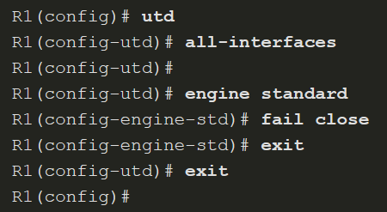
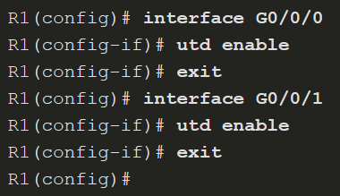
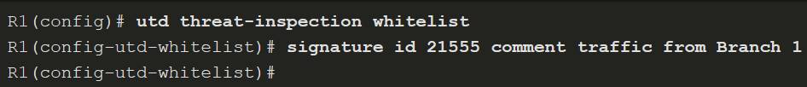
Configure Snort IPS
Step 6. Enable IPS Globally or on Desired Interfaces
Globally
Selected Interfaces
You can enable UTD globally on all interfaces or on selected interface.
You can also enable the UTD allowed list feature. This enables you to identify IPS signature IDs to be suppressed (not used)
Notes:
12: IPS Operation and Implementation 12.3: Configure Snort IPS 12.3.7: Enable Unified Threat Defense (UTD)

Slide 60
Configure Snort IPS
Step 7. Verify Snort IPS
After Snort IPS is implemented, it is necessary to verify the configuration to ensure correct operation.
There are several show commands that can be used to verify the Snort IPS configuration and operation.
show virtual-service list - The command displays an overview of resources that are utilized by the applications.
show virtual-service detail - The command displays a list of resources that are committed to a specified application, including attached devices.
show utd engine standard config - The command displays the UTD configuration.
show utd engine standard status - The command displays the status of the UTD engine.
show platform hardware qfp active feature utd stats - The command checks the data plane. It verifies increments for encap, decap, redirect, and reinject and displays a health of "Green".
Notes:
12: IPS Operation and Implementation 12.3: Configure Snort IPS 12.3.8: Verify Snort IPS
12.3.9: Syntax Checker - Configure Snort IPS
12.3.10: Check Your Understanding - Implementing Snort IPS

Slide 61
Module 13: Endpoint Security
Instructor Materials
Networking Security v1.0
(NETSEC)
Notes:
Networking Security (NETSEC) Module 13: Endpoint Security

Slide 62
Module Objectives
Module Title: Endpoint Security
Module Objective: Explain endpoint vulnerabilities and protection methods.
Topic Title | Topic Objective
Endpoint Security Overview | Describe endpoint security and the enabling technologies.
802.1X Authentication | Explain the functions of 802.1x components.
Notes:
62
13 – Endpoint Security
13.0.2 – What will I learn to do in this module?

Slide 63
13.1 Endpoint Security Overview
Notes:
13: Endpoint Security 13.1: Endpoint Security Overview

Slide 64
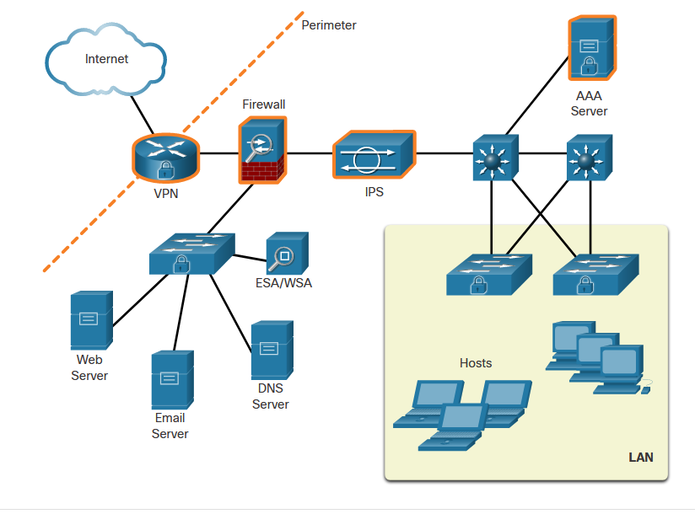
Endpoint Security Overview
LAN Elements Security
Various network security devices are required to protect the network perimeter from outside access. As shown in the figure, these devices could include a hardened ISR that is providing VPN services, an ASA firewall appliance, an IPS, and a AAA server.
Because many attacks originate from inside the network, securing an internal LAN is just as important as securing the outside network perimeter.
Specifically, there are two internal LAN elements to secure:
Endpoints
Network infrastructure
Notes:
13: Endpoint Security 13.1: Endpoint Security Overview 13.1.1: LAN Elements Security

Slide 65
Endpoint Security Overview
Traditional Endpoint Security
Historically, employee endpoints were company-issued computers which resided within a clearly defined LAN perimeter. These hosts were protected by firewalls and IPS devices which worked well with hosts that were connected to the LAN and behind the firewall.
The endpoints also used traditional host-based security measures:
Antivirus/Antimalware Software
Host-based IPS
Host-based firewall
Notes:
13: Endpoint Security 13.1: Endpoint Security Overview 13.1.2: Traditional Endpoint Security

Slide 66
Endpoint Security Overview
The Borderless Network
The new bring-your-own-device (BYOD) needs of workers have a required a different way of approaching endpoint security.
In many networks, the network-based devices are disparate and typically do not share information among themselves. Additionally, new endpoint devices are not good candidates for the traditional host-based endpoint security solutions because of the variety of devices and the variety of operating systems available on those devices.
Notes:
13: Endpoint Security 13.1: Endpoint Security Overview 13.1.3: The Borderless Network

Slide 67
Endpoint Security Overview
Security for Endpoints in the Borderless Network
Organizations must also protect their endpoints from new threats and provide the protection measures that are outlined in the table below:
Measure | Purpose
antimalware software | Protect endpoints from malware.
spam filtering | Prevent spam emails from reaching endpoints.
blocklisting | Prevent endpoints from connecting to websites with bad reputations by immediately blocking connections based on the latest reputation intelligence.
data loss prevention (DLP) | Prevent sensitive information from being lost or stolen.
Vedeli ste že M365 E5/A5 podporuje DLP? Viac na Microsoft Purview
Microsoft Purview Information Protection | Microsoft Learn
a data loss prevention Learn about data loss prevention | Microsoft Learn
Notes:
13: Endpoint Security 13.1: Endpoint Security Overview 13.1.4: Security for Endpoints in the Borderless Network

Slide 68
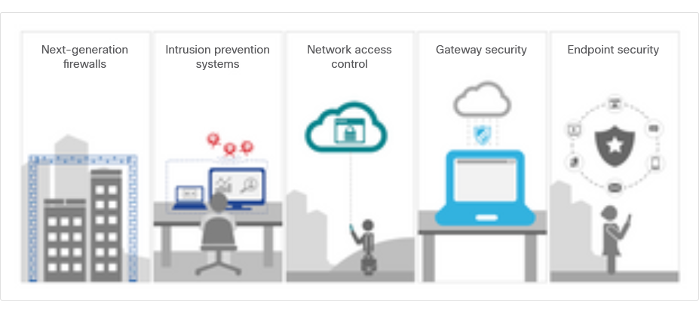
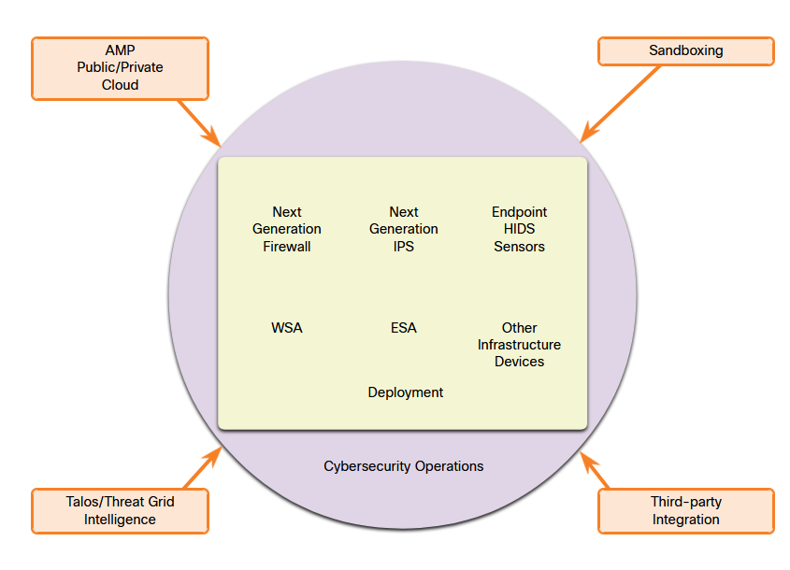
Endpoint Security Overview
Network-Based Malware Protection
Protecting endpoints in a borderless network can be accomplished using network-based, as well as host-based techniques, as shown in the figure.
The following are examples of devices and techniques that implement host protections at the network level:
Advanced Malware Protection (AMP)
Email Security Appliance (ESA)
Web Security Appliance (WSA)
Network Admission Control (NAC)
Notes:
13: Endpoint Security 13.1: Endpoint Security Overview 13.1.5: Network-Based Malware Protection

Slide 69
Endpoint Security Overview
Hardware and Software Encryption of Local Data
Endpoints are also susceptible to data theft. For instance, if a corporate laptop is lost or stolen, a thief could scour the hard drive for sensitive information, contact information, personal information, and more.
The solution is to locally encrypt the disk drive with a strong encryption algorithm such as 256-bit AES encryption. The encryption protects the confidential data from unauthorized access. The encrypted disk volumes can only be mounted for normal read/write access with the authorized password.
Notes:
13: Endpoint Security 13.1: Endpoint Security Overview 13.1.6: Hardware and Software Encryption of Local Data

Slide 70
Endpoint Security Overview
Network Access Control
The purpose of network access control (NAC) is to allow only authorized and compliant systems, whether managed or unmanaged, to access the network. It unifies endpoint security technologies with user or device authentication and network security policy enforcement.
NAC systems can have the following capabilities:
Profiling and visibility – This recognizes users and their devices before malicious code can cause damage.
Guest network access – This manages guests through a customizable, self-service portal that includes guest registration, guest authentication, guest sponsoring, and a guest management portal.
Security posture checking – This evaluates security-policy compliance by user type, device type, and operating system.
Incident response - Mitigating network threats by enforcing security policies that block, isolate, and repair noncompliant machines without administrator attention.
Notes:
13: Endpoint Security 13.1: Endpoint Security Overview 13.1.7: Network Access Control

Slide 71
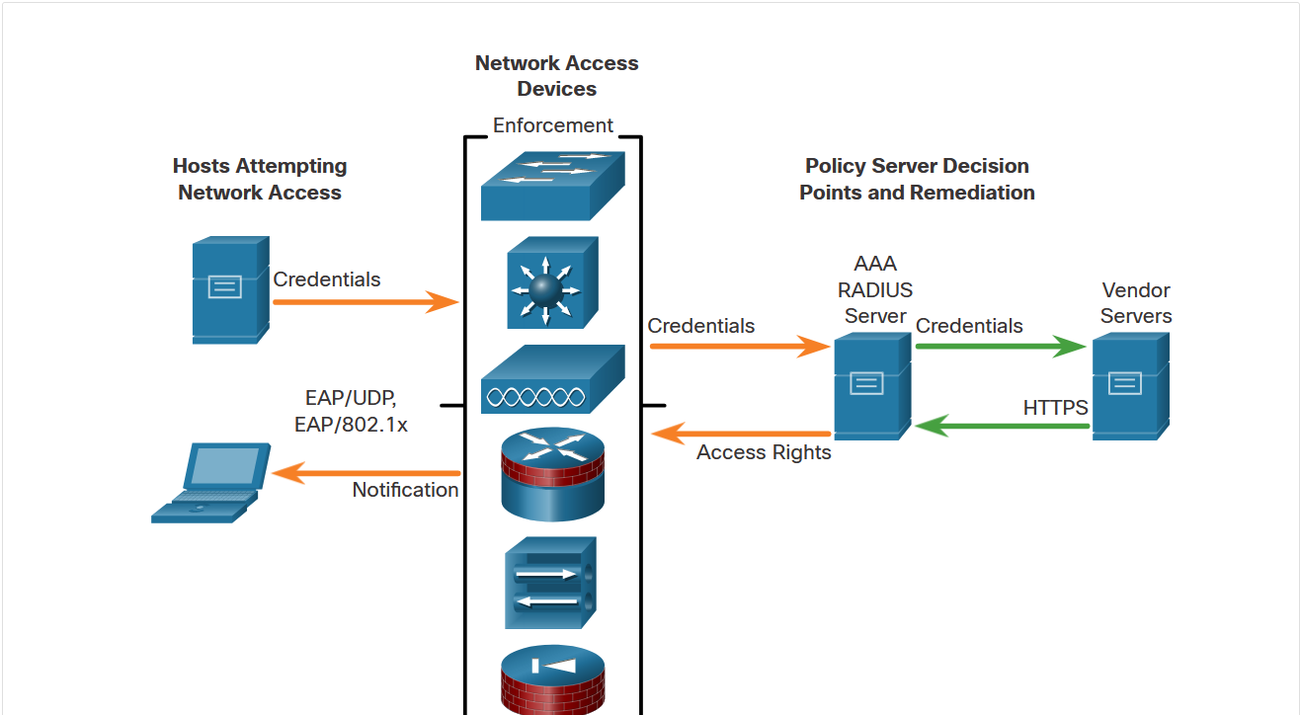
Endpoint Security Overview
NAC Functions
The goal of NAC systems is to ensure that only hosts that are authenticated and have had their security posture examined and approved are permitted onto the network.
Network access devices can function as the enforcement layer, as shown in the figure. They force the clients to query a RADIUS server for authentication and authorization. The RADIUS server can query other devices, such as an antivirus server, and reply to the network enforcers.
Notes:
13: Endpoint Security 13.1: Endpoint Security Overview 13.1.8: NAC Functions
13.1.9: Check Your Understanding - Identify Endpoint Security Terminology

Slide 72
13.2 802.1X Authentication
Notes:
13: Endpoint Security 13.2: 802.1X Authentication

Slide 73
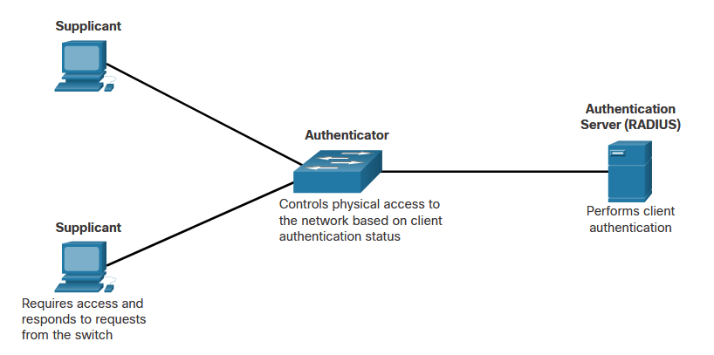
802.1X Authentication
Security Using 802.1X Port-Based Authentication
The IEEE 802.1X standard defines a port-based access control and authentication protocol that restricts unauthorized workstations from connecting to a LAN through publicly accessible switch ports. The authentication server authenticates each workstation that is connected to a switch port before making available any services offered by the switch or the LAN.
The figure shows that with 802.1X port-based authentication, the devices in the network have specific roles.
Notes:
13: Endpoint Security 13.2: 802.1X Authentication 13.2.1: Security Using 802.1X Port-Based Authentication

Slide 74
802.1X Authentication
Security Using 802.1X Port-Based Authentication (Cont.)
The 802.1x roles include:
Supplicant (Client) - The device (workstation) that requests access to LAN and switch services and then responds to requests from the switch. The workstation must be running 802.1X-compliant client software. (The port that the client is attached to is the supplicant [client] in the IEEE 802.1X specification.)
Authenticator (Switch) - Controls physical access to the network based on the authentication status of the client. The switch acts as an intermediary (proxy) between the client (supplicant) and the authentication server, requesting identifying information from the client, verifying that information with the authentication server, and relaying a response to the client. The switch uses a RADIUS software agent, which is responsible for encapsulating and de-encapsulating the EAP (Extensible Authentication Protocol) frames and interacting with the authentication server.
Authentication server - Performs the actual authentication of the client. The authentication server validates the identity of the client and notifies the switch whether the client is authorized to access the LAN and switch services. Because the switch acts as the proxy, the authentication service is transparent to the client. The RADIUS security system with EAP extensions is the only supported authentication server.
Notes:
13: Endpoint Security 13.2: 802.1X Authentication 13.2.1: Security Using 802.1X Port-Based Authentication

Slide 75
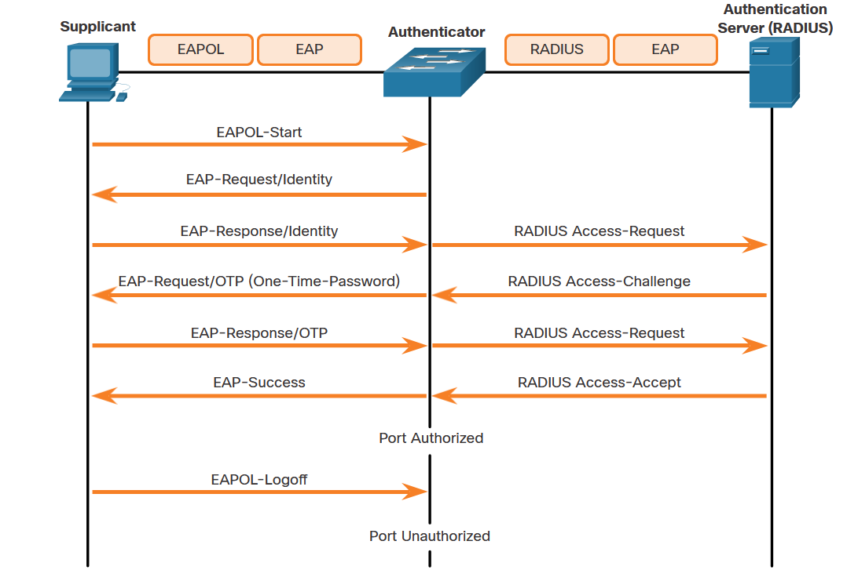
802.1X Authentication
Security Using 802.1X Port-Based Authentication (Cont.)
The figure shows the complete message exchange between the supplicant, authenticator, and the authentication server. The encapsulation occurs as follows:
Between the supplicant and the authenticator - EAP data is encapsulated in EAPOL frames.
Between the authenticator and the authentication server - EAP data is encapsulated using RADIUS.
Rozdiel medzi EAP (Extensible Authentication Protocol) a EAPOL (Extensible Authentication Protocol over LAN) spočíva v ich použití a spôsoboch prenosu:
EAP:
EAP je samotný autentifikačný protokol, ktorý podporuje rôzne autentifikačné metódy, ako sú napríklad EAP-TLS, EAP-TTLS, PEAP a ďalšie.
Používa sa na autentifikáciu medzi klientom (supplicant) a autentifikačným serverom (napríklad RADIUS serverom).
EAPOL:
EAPOL je spôsob, akým sa EAP správy prenášajú cez lokálne siete (LAN), ako sú Ethernet alebo bezdrôtové siete.
EAPOL sa používa v rámci 802.1X autentifikácie, kde sa autentifikačné správy prenášajú medzi klientom (supplicant) a autentifikátorom (napríklad prístupovým bodom alebo switchom) predtým, než sa dostanú na autentifikačný server
Notes:
13: Endpoint Security 13.2: 802.1X Authentication 13.2.1: Security Using 802.1X Port-Based Authentication

Slide 76
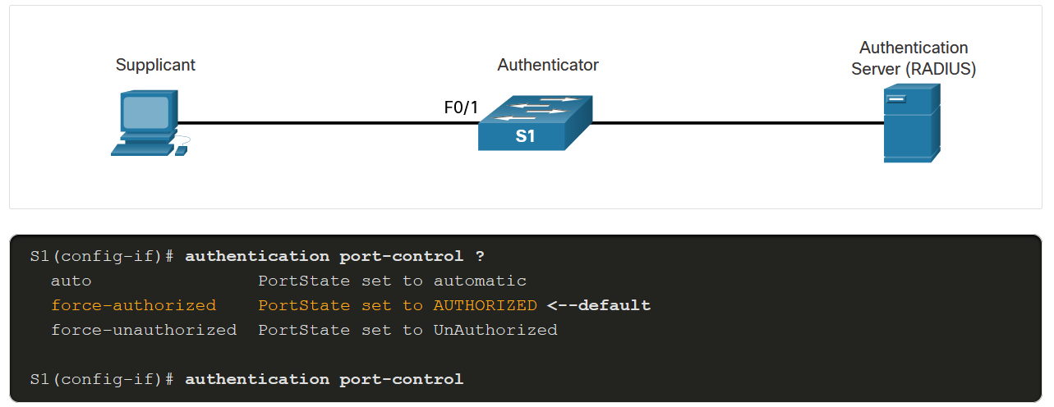
802.1X Authentication
Control the 802.1X Authorization State
It may be necessary to configure a switch port to override the 802.1X authentication process. To do this, use the authentication port-control interface configuration command to control the port authorization state. The syntax for the command and a description of the parameters are shown below.
Parameter | Description
auto | Enables 802.1X port-based authentication and causes the port to begin in the unauthorized state. During this time only EAPOL, STP, and CDP frames are the only type of frames that can be sent or received through the port until the client device has been authenticated.
force-authorized | The port sends and receives normal traffic without 802.1x-based authentication of the client. This is the default setting.
force-unauthorized | Causes the port to remain in the unauthorized state, ignoring all attempts by the client to authenticate. The switch cannot provide authentication services to the client through the port.
Notes:
13: Endpoint Security 13.2: 802.1X Authentication 13.2.2: Control the 802.1X Authorization State

Slide 77
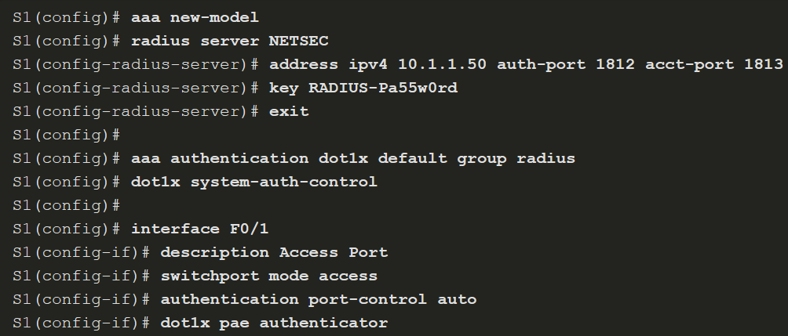
802.1X Authentication
802.1X Configuration
802.1X Configuration requires a few basic steps:
Step 1. Enable AAA using the aaa new-model command.
Step 2. Designate the RADIUS server and configure its address and ports.
Step 3. Create an 802.1X port-based authentication method list using the aaa authentication dot1x command.
Notes:
13: Endpoint Security 13.2: 802.1X Authentication 13.2.3: 802.1X Configuration
13.2.4: Syntax Checker - Configure 802.1x Port-Authentication

Slide 78
802.1X Authentication
802.1X Configuration (Cont.)
Step 4. Globally enable 802.1X port-based authentication using the dot1x system-auth-control command.
Step 5. Enable port-based authentication on the interface using the authentication port-control auto command.
Step 6. Enable 802.1X authentication on the interface using the dot1x pae command. The authenticator options sets the Port Access Entity (PAE) type so the interface acts only as an authenticator and will not respond to any messages meant for a supplicant.
Notes:
13: Endpoint Security 13.2: 802.1X Authentication 13.2.3: 802.1X Configuration
13.2.4: Syntax Checker - Configure 802.1x Port-Authentication

